Slide 1
Process Improvement Opportunity: Leverage Machine Learning & AI to Speed-Up Your Home Loan Process
Target Stakeholder Group: JPMorgan Chase & Co.’s clients

Slide 2
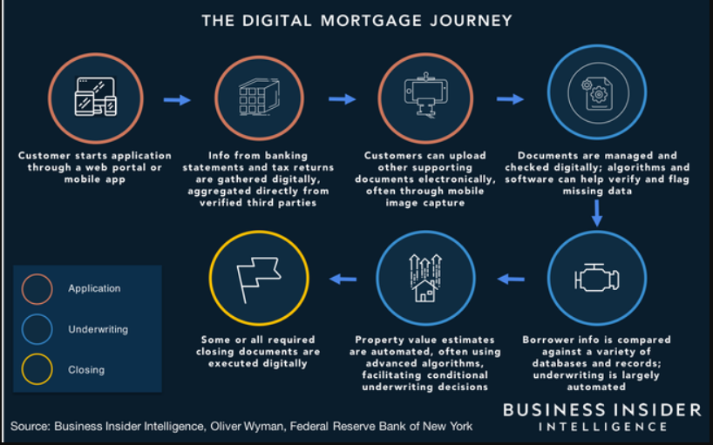
How AI & ML will help me speed-up home loan process ?

Slide 3
Machine Learning (ML) and Artificial Intelligence (AI) can speed up the home loan process in several ways:
That visualization was impressive but can you provide me details ?
Automated Underwriting: AI and ML algorithms can analyze a borrower's financial information, credit score, and other relevant data to determine if they qualify for a home loan. This can save a significant amount of time as it eliminates the need for manual underwriting.
Predictive Analytics: By analyzing data from previous home loan applications, AI and ML algorithms can predict the likelihood of a borrower defaulting on their loan, which can help lenders make more informed lending decisions.
Chatbots: AI-powered chatbots can help answer borrower's questions and concerns during the home loan application process. This can provide borrowers with immediate assistance, reduce wait times, and improve the overall customer experience.
Document Processing: ML algorithms can process large volumes of documents such as income statements, tax returns, and bank statements, quickly and accurately. This can save a significant amount of time as it eliminates the need for manual data entry.
Fraud Detection: AI and ML algorithms can detect fraudulent activity in the loan application process, such as fake documents or identity theft. This can help lenders prevent fraud and speed up the loan application process.

Slide 4
Summary
AI and ML technologies are increasingly being used in the home loan process to automate and streamline various aspects of the process, from loan origination to underwriting and servicing. These technologies can help lenders make more accurate and informed decisions about loan approvals and risk assessment, while also improving the borrower experience by reducing processing times and increasing transparency.
Overall, AI and ML have the potential to significantly improve the efficiency and accuracy of the home loan process, while also providing a better experience for borrowers. As these technologies continue to evolve, we can expect to see even more innovative use cases in the future.

